Slide 1
Standard Representations of Regular Languages
Regular Languages
DFAs
Regular
Grammars
NFAs
Regular
Expressions

Slide 2

When we say:
We are given
a Regular Language
We mean:
Language is in a standard
representation

Slide 3
Elementary Questions about
Regular Languages

Slide 4


Membership Question
Question:
Given regular language
and string
how can we check if ?
Answer:
Take the DFA that accepts
and check if is accepted

Slide 5


DFA
DFA

Slide 6
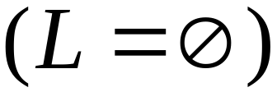
Question:
Given regular language
how can we check
if is empty: ?
Answer:
Take the DFA that accepts
Check if there is any path from
the initial state to a final state

Slide 7


DFA
DFA

Slide 8
Question:
Given regular language
how can we check
if is finite?
Answer:
Take the DFA that accepts
Check if there is a walk with cycle
from the initial state to a final state

Slide 9
DFA
is infinite
DFA
is finite

Slide 10


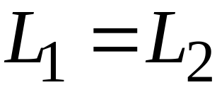
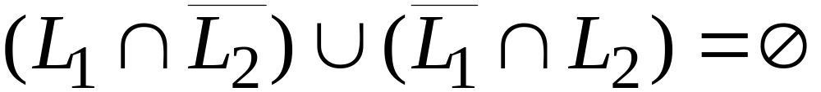
Question:
Given regular languages and
how can we check if ?
Answer:
Find if

Slide 11
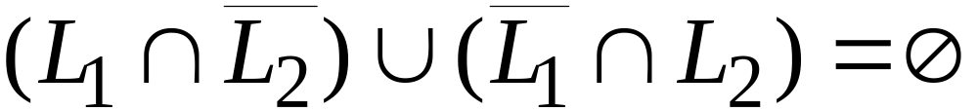
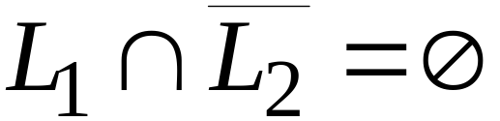
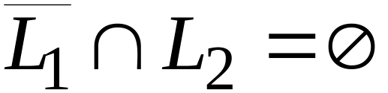


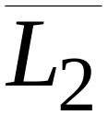
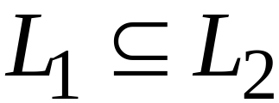
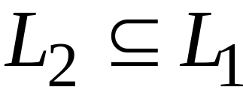
and

Slide 12
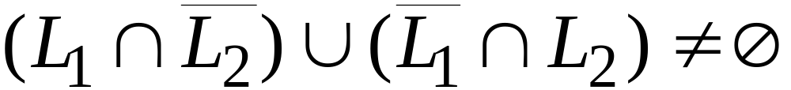
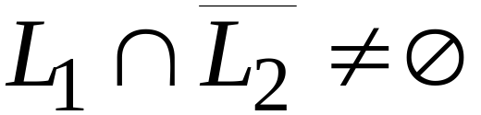
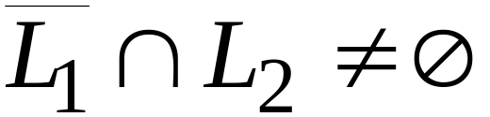
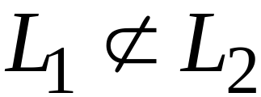
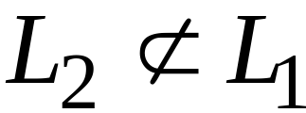
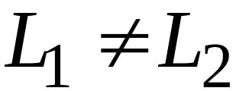
or

Slide 13
Non-regular languages

Slide 14
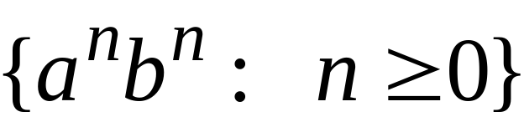
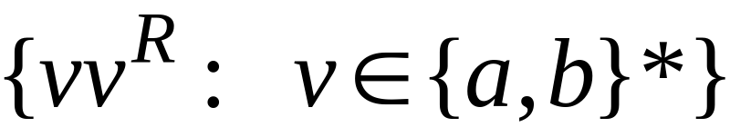


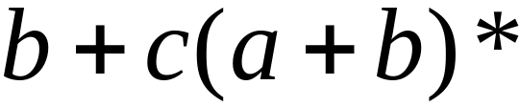

Non-regular languages
Regular languages

Slide 15
How can we prove that a language
is not regular?
Prove that there is no DFA that accepts
Problem: this is not easy to prove
Solution: the Pumping Lemma !!!

Slide 16

The Pigeonhole Principle

Slide 17


pigeons
pigeonholes

Slide 18
A pigeonhole must
contain at least two pigeons

Slide 19



pigeons
...........
pigeonholes
...........

Slide 20
The Pigeonhole Principle
pigeons
pigeonholes
There is a pigeonhole
with at least 2 pigeons
...........

Slide 21
The Pigeonhole Principle and
DFAs

Slide 22




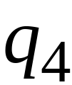


DFA with states

Slide 23
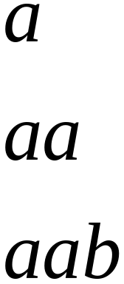
In walks of strings:
no state
is repeated

Slide 24
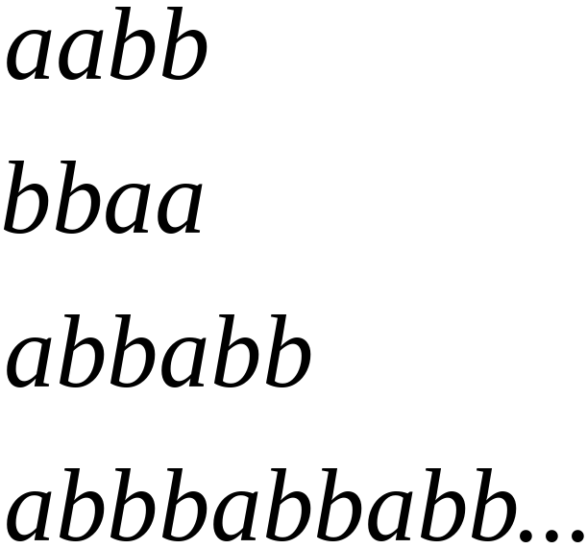
In walks of strings:
a state
is repeated

Slide 25
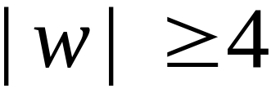
If string has length :
Then the transitions of string
are more than the states of the DFA
Thus, a state must be repeated

Slide 26



In general, for any DFA:
String has length number of states
A state must be repeated in the walk of
walk of
......
......
Repeated state

Slide 27
In other words for a string :
transitions are pigeons
states are pigeonholes
walk of
......
......
Repeated state

Slide 28
The Pumping Lemma

Slide 29

Take an infinite regular language
There exists a DFA that accepts
states

Slide 30
Take string with
There is a walk with label :
.........
walk

Slide 31
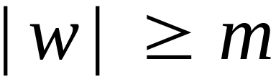
If string has length
(number
of states
of DFA)
then, from the pigeonhole principle:
a state is repeated in the walk
......
......
walk

Slide 32
Let be the first state repeated in the
walk of
......
......
walk

Slide 33




Write
......
......

Slide 34


Observations:
length
number
of states
of DFA
length
......
......

Slide 35

Observation:
The string
is accepted
......
......

Slide 36

Observation:
The string
is accepted
......
......

Slide 37

Observation:
The string
is accepted
......
......

Slide 38
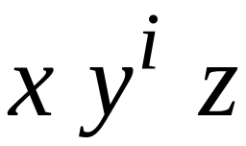

In General:
The string
is accepted
......
......

Slide 39
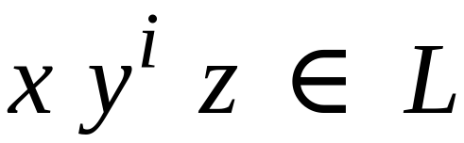
In General:
Language accepted by the DFA
......
......

Slide 40
In other words, we described:
The Pumping Lemma !!!

Slide 41


The Pumping Lemma:
Given a infinite regular language
there exists an integer
for any string with length
we can write
with and
such that:

Slide 42
Applications of the Pumping Lemma

Slide 43

Theorem:
The language
is not regular
Proof:
Use the Pumping Lemma

Slide 44
Assume for contradiction
that is a regular language
Since is infinite
we can apply the Pumping Lemma

Slide 45
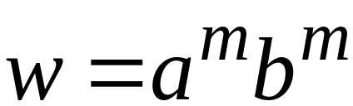
Let be the integer in the Pumping Lemma
Pick a string such that:
length
We pick

Slide 46
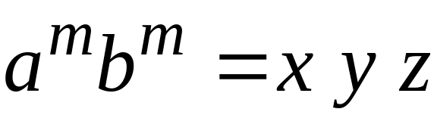

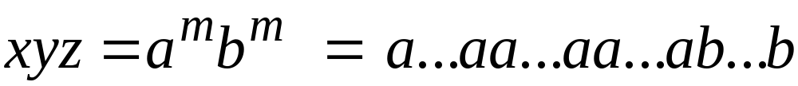
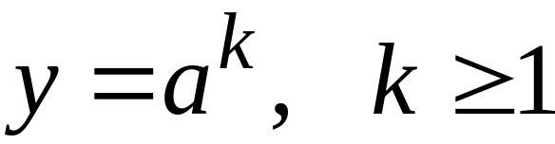
Write:
From the Pumping Lemma
it must be that length
Thus:

Slide 47
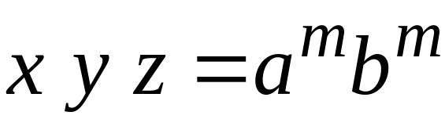

From the Pumping Lemma:
Thus:

Slide 48

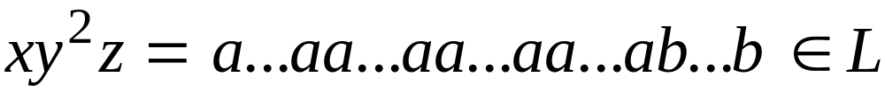
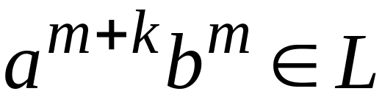
From the Pumping Lemma:
Thus:

Slide 49
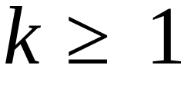
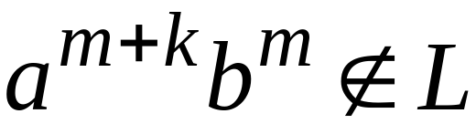
BUT:
CONTRADICTION!!!

Slide 50
Therefore:
Our assumption that
is a regular language is not true
Conclusion:
is not a regular language

Slide 51
Non-regular languages
Regular languages

